Slide 1
SKETCH COMEDY
improvisation

Slide 2
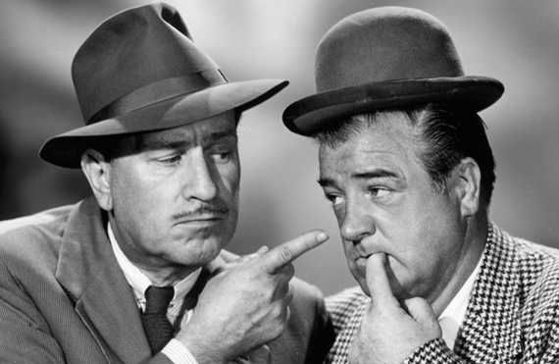
Original Sketch Comedy!
Abbott & Costello “Who’s on First?”
http://youtu.be/kTcRRaXV-fg
Abbott & Costello “Explain The Stimulus Plan”
http://youtu.be/6ib9N7L9y08

Slide 3
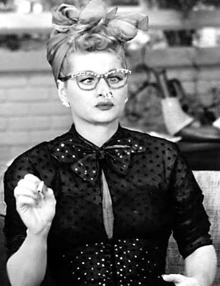
I Love Lucy
Job Switching
https://youtu.be/Jm1VEO9C4VQ
Vitameatavegamin
https://youtu.be/q2Z264w9_2Q

Slide 4
Step 1: Keep a Comedy Diary
Carry a notebook around with you for at least a week and write down anything you see or hear that makes you smile or laugh. Write the details!
When you laughed, was it at something/someone?
Why did you laugh? Was it something visual?
Maybe the words sounded funny?
Or was it because the joke reminded you of something funny in your own life?
Be specific as to why you laughed.

Slide 5
Step 2: Narrowing the ideas
After collecting ideas, pick the 3 best ideas and throw all the other ideas in the trash.
Do this by looking throughout the diary and look for the best comedic potential.
What stands out? What is different?

Slide 6
Step 3: Add Titles
Now think of a title for each idea and write the title at the top of three separate pages.
The Titles should be short and simple AND do not have to necessary have to directly represent what actually happened in the event.

Slide 7
Step 4: Brainstorm
Write down everything you can think of connected to the event which originally took place.
List everything you can think of including…
Words / phrases / related subjects
(2 minutes – go)
Now, choose 3 settings, 5 characters, and 3 conflicts for each title/idea.
(2 minutes – go)

Slide 8
Step 5: Selection
Now look at all three ideas. Review the brainstorming and possible settings, characters and conflicts for each.
Pick the one that appears to have the best comic potential and put it on the top of the pile. Put at #1 at the TOP. (#2 and the second best and #3 on the third best)
Now, SELECT (by circling) 1 setting, 3 characters and 1-2 conflicts for this idea.
This will be the idea you will write your sketch for.

Slide 9
Step 6: Write the Sketch
Now you can take the chosen idea and begin writing your sketch. When writing, it is always best to work with a partner or a group of people to bounce ideas off one another.
Review the types of sketches (next slide)
Include the elements of comedy, farce, tragedy and melodrama into the sketch

Slide 10
Types of Sketches
1. ESCALATION
ideas start small and get bigger and bigger, ending in complete chaos of ridiculous proportions
2. LISTS
when the bulk of the dialogue is a long list of funny items ex: “Cheese Shop”, Monty Python
3. MAD MAN, SANE MAN
speaks for itself - don’t go for obvious settings
4. DANGEROUS SITUATION
speaks for itself - ex: set on flight deck of aircraft
5. FUNNY WORDS
the sound of the language itself is funny - ex: “blobby” or “wobble” in Mr. Bean
6. OLD AND NEW
putting something modern in an historical setting - ex: Sir Walter Raleigh using a cigarette lighter
7. BIG AND SMALL
humor from large differences in scale - ex: a mouse trying to be romantic to an elephant

Slide 11
Step 7: Edit the Sketch
When you have finished writing your sketch remember.. it is only the first draft!!!! Go back and look at it again.
Improve it. Change it. Make it funnier. If there isn’t a big laugh at least every fifteen seconds, put one in.

Slide 12
Step 8: Sleep on It!
Go to bed and look at your material when you wake up in the morning. If it’s still as funny as you thought it was when you wrote it, GREAT!!!
If it isn’t, THROW IT AWAY. Don’t waste time trying to rescue an idea that doesn’t work. Go onto writing a NEW sketch

Slide 13
Helpful Hints
1. Write short, tight sketches
don’t make the sketch more than 2 min.
2. consider yourself on a tight budget
Don’t include anything too expensive, like a helicopter...
3. THREE characters is more than enough for a 2 minute sketch

Slide 14
Helpful Hints
4. Work backwards - sketches should have a strong finish, so work backwards.
So, think of the punch line first
If you can’t think of one after 10 minutes, then there probably isn’t one there... TRASH IT and go onto the next sketch
Once you have the funny ending, work out how to get there
When you have worked out the whole of the last 10 seconds of the sketch, it’s probably safe to go and think about the beginning.

Slide 15
Helpful Hints
5. work out loud
say the lines as you write them... you need to hear what the material sounds like
6. think out it visually
describe the physical action in detail
what are the characters wearing? what do they look like? what are their names?
7. put a “spin” on it
do not approach the sketch in the obvious ways

Slide 16
AND REMEMBER….
Be Brutal with your work!!
Be persistent!!
Study other comedians; not to copy their set, but to understand their process

Slide 17
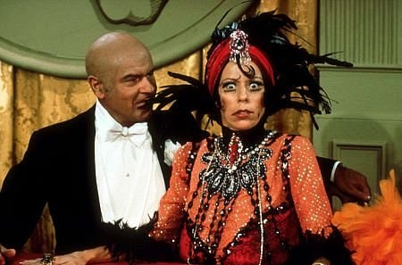
The Carol Burnett Show
The Trainee
https://youtu.be/75iIotHMvU0
The Dentist
https://youtu.be/bfTyEtVIe84
The Queen - Palace Guard
https://youtu.be/z3yP6ZtW1z0
Old Man Ship Slaves
https://youtu.be/Z7B2Tu6-G5E

Slide 18
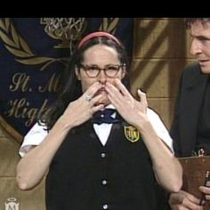
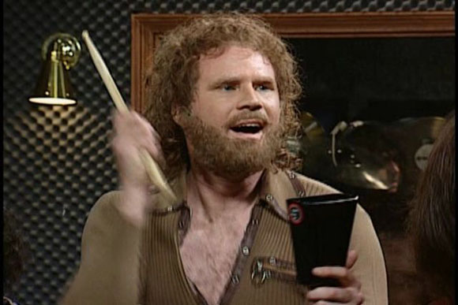
Saturday Night Live
Motivational Speaker
https://youtu.be/Xv2VIEY9-A8
Festrunk Brothers
https://youtu.be/YGv6uo89yMY
Cheerleaders
https://youtu.be/WifF0kZ0zp4
More Cowbell
http://www.hulu.com/watch/536145
Celebrity Jeopardy
https://youtu.be/bEghu90QJH4
Mary Katherine Gallagher
https://youtu.be/MHOeyLKYFqg
Church Lady
https://youtu.be/FuJpalsj9sQ

Slide 19
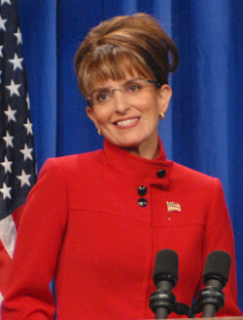
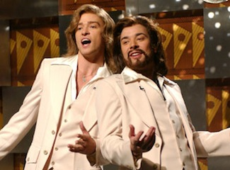
Saturday Night Live
Debbie Downer
https://youtu.be/TfE93xON8jk
Waynes World
https://youtu.be/o2uy-EW2Dmc
Mom Jeans
https://youtu.be/2aVxNH6iN9I
Palin
https://youtu.be/_0vVKZL-Z7I
The Californians
https://youtu.be/wC2fdRnBEoY
Barry Gibb Talk Show
https://youtu.be/6_Ea5a19jTc
Family feud
https://youtu.be/eZ6_vAXNcxQ

